Slide 1
Syntax analysis
Week 3
Amna Irum

Slide 2
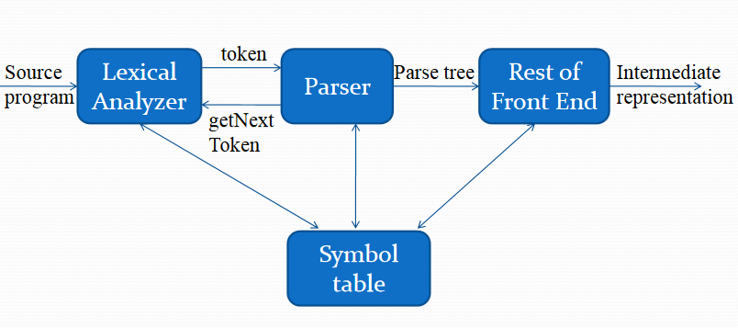
The Role of parser

Slide 3
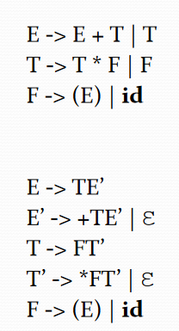
Representatives of Grammar

Slide 4
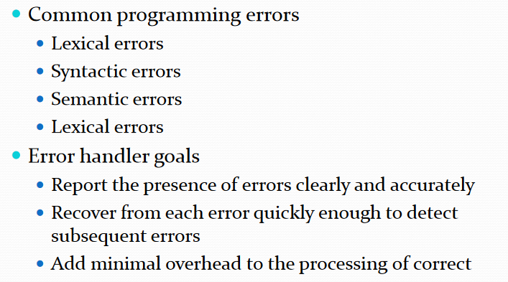
Error Handling

Slide 5
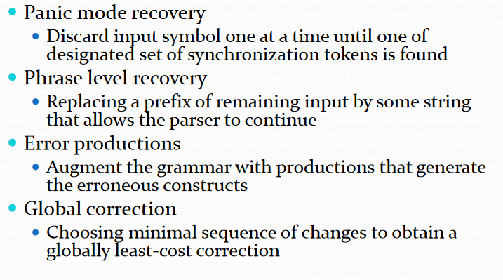
Error-Recover Strategy

Slide 6
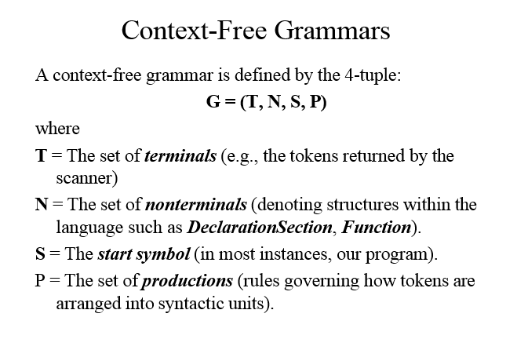

Slide 7
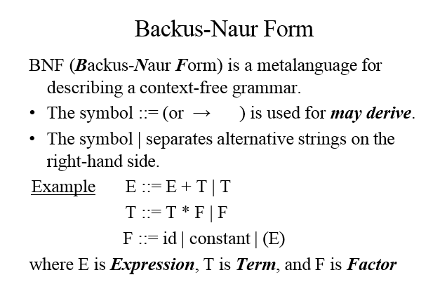

Slide 8
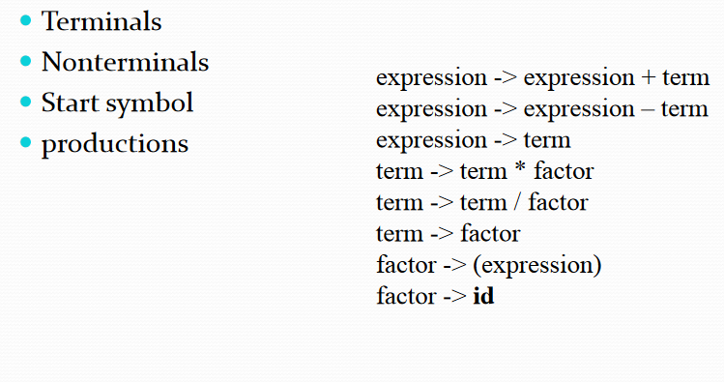
Context Free Grammars

Slide 9
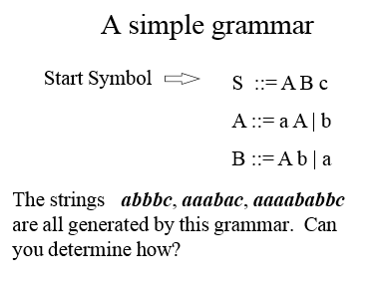

Slide 10
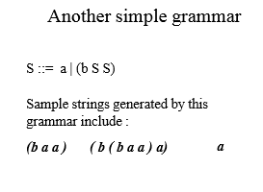
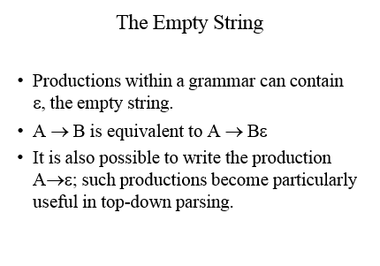

Slide 11

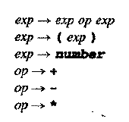


Slide 12
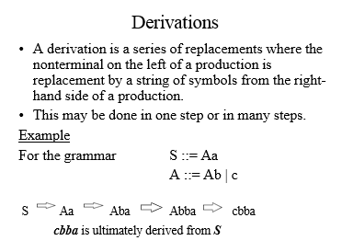

Slide 13
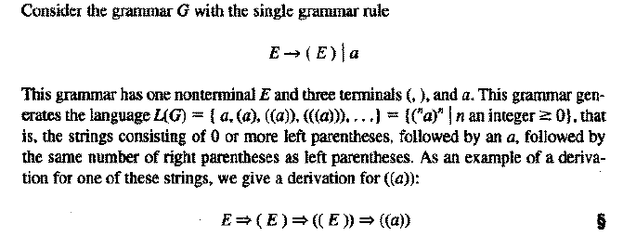


Slide 14
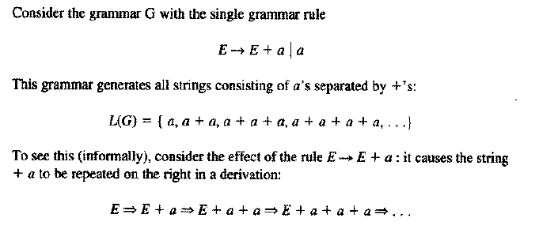

Slide 15
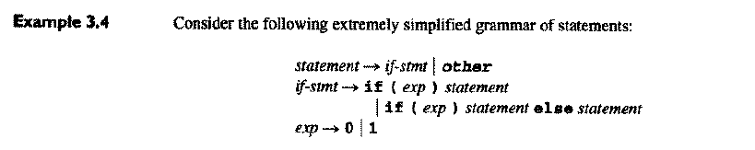
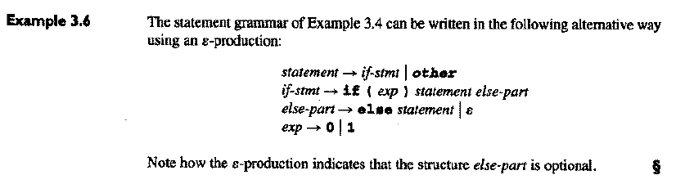

Slide 16

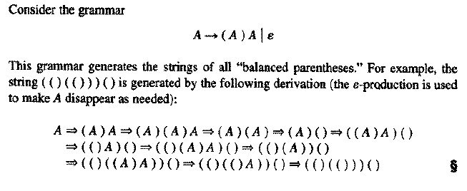

Slide 17
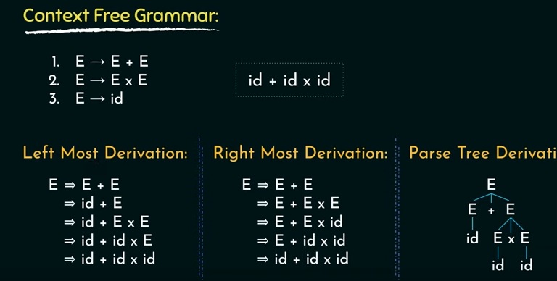

Slide 18
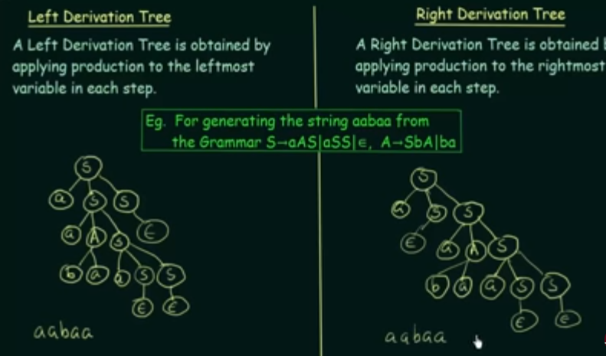
Derivations

Slide 19
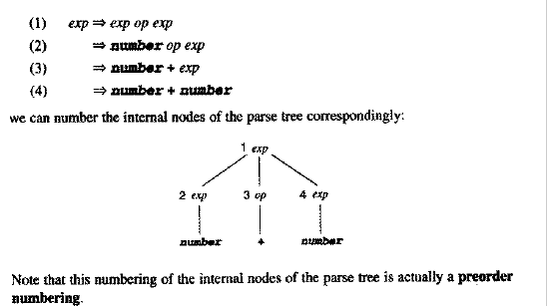
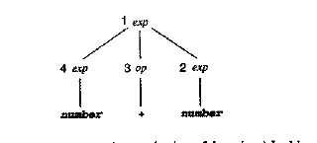
Left most derivation and Right most derivation

Slide 20
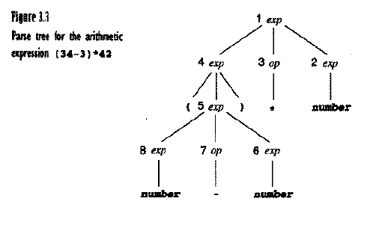

Slide 21
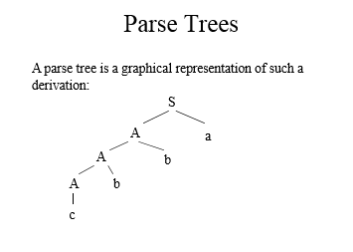

Slide 22
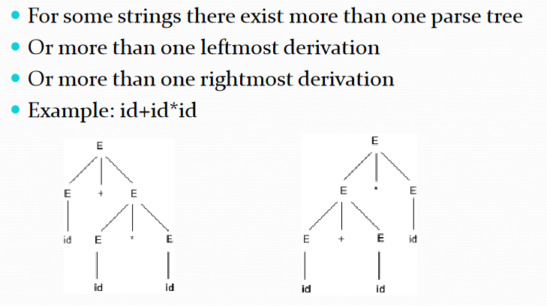
Ambiguity

Slide 24
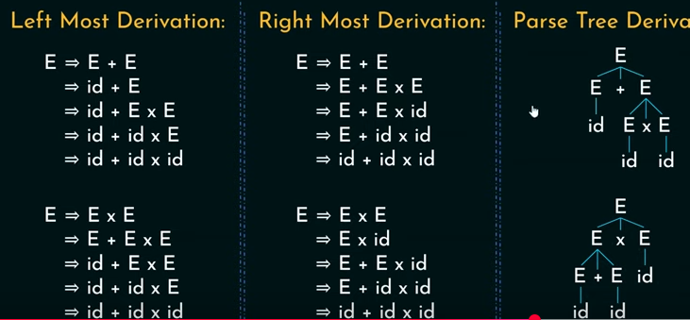

Slide 25

Check for 3+4*5 also 3-4-5

Slide 26
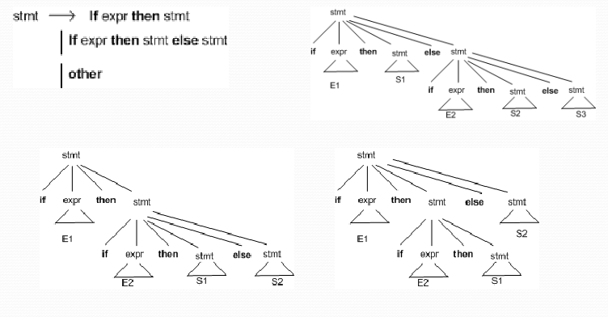
Elimination

Slide 27
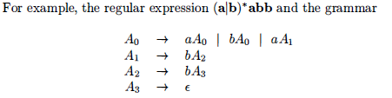
Context free Grammar vs Regular Exp
Every construct that can be described by a regular expression can be described by a grammar,
but not vice-versa.
"finite automata cannot count," meaning that
a finite automaton cannot accept a language like {an bn}

Slide 28
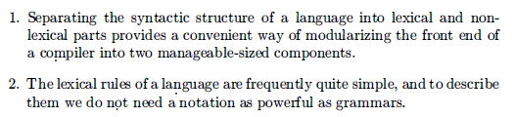

Slide 29
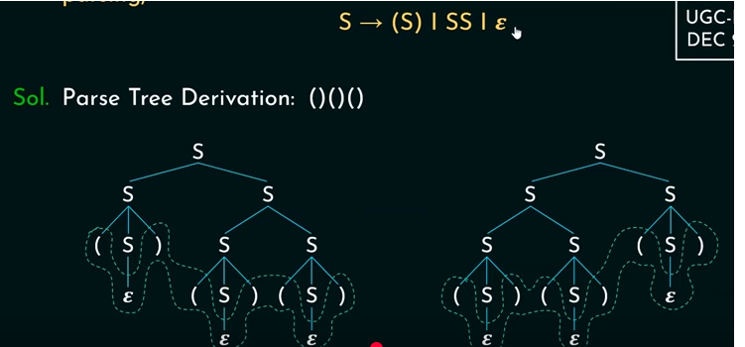
Example for ambiguous Grammars

Slide 30
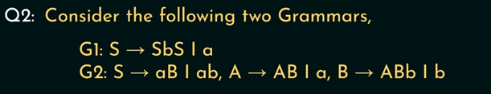
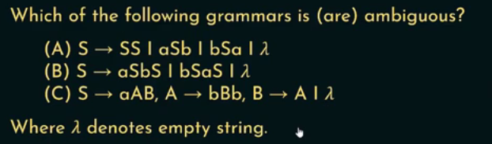

Slide 31
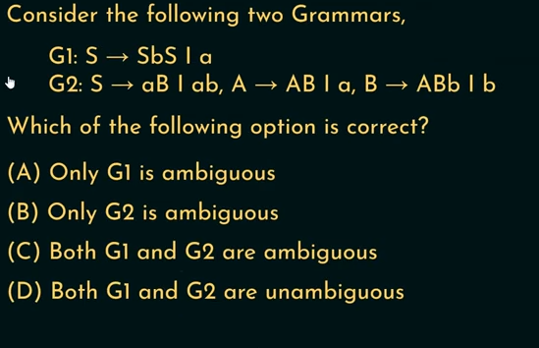

Slide 32
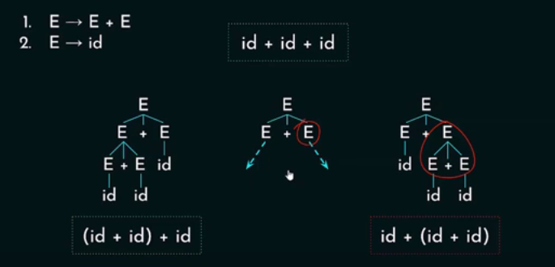
Associativity Problem

Slide 33
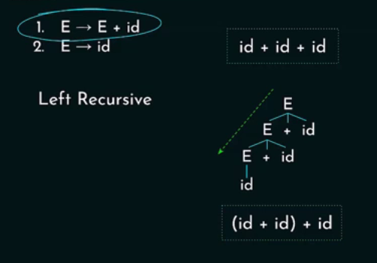
Solution

Slide 34
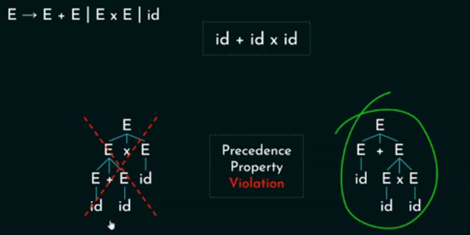
Precedence Problem

Slide 35
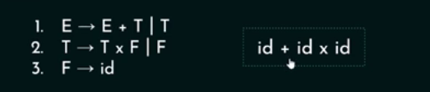
Solution

Slide 36
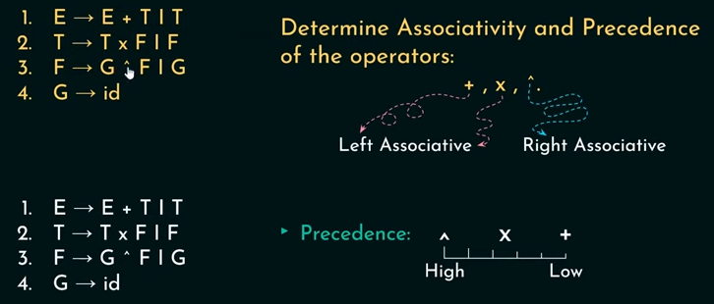
Examples

Slide 37
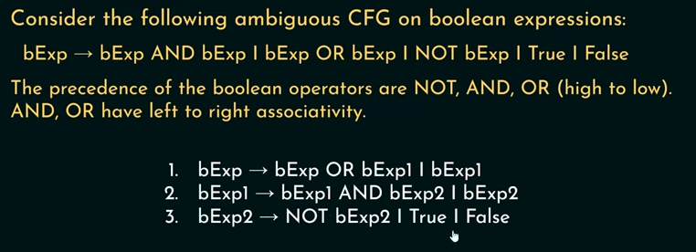

Slide 38
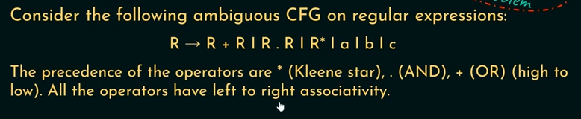
Exercise

Slide 39
Solution
R -> R + R1 | R1
R1 -> R1.R2 | R2
R2 -> R2* | a | b | c

Slide 40
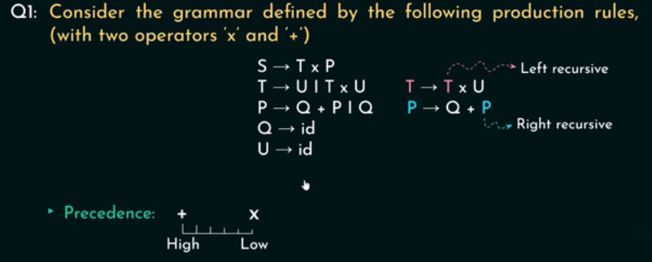
Examples

Slide 41
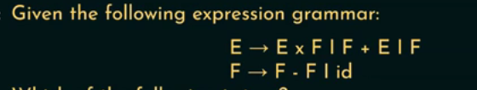

Slide 42
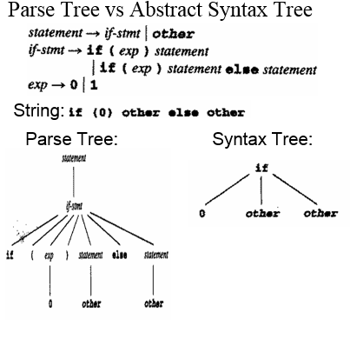

Slide 43
If-Else Ambiguous Grammar

Slide 44
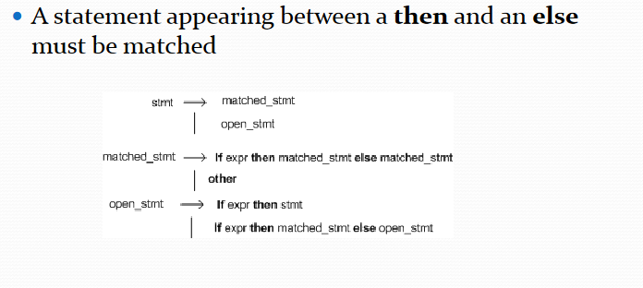
Ambiguity elimination

Slide 45
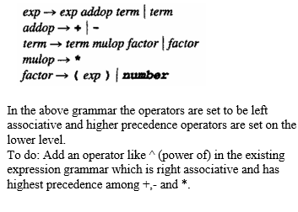
Question

Slide 46
Grammar Rule
1.Grammar Rules
  Precedence (from highest to lowest):
    Multiplicative operators (*, /, %) have the highest precedence.
    Additive operators (+, -) have the next level of precedence.
    Relational operators (<, >, <=, >=, ==, !=) have the lowest precedence.
  Associativity:
    Multiplicative and additive operators are left-associative.
    Relational operators are left-to-right associative (e.g., a < b < c is evaluated as (a < b) < c).

Slide 47
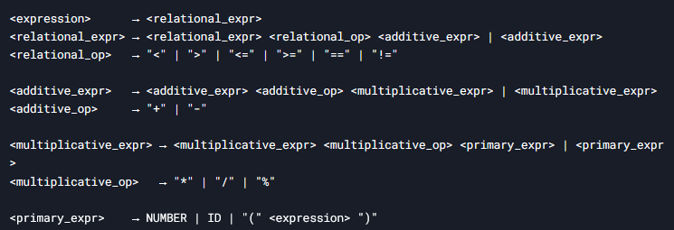
Grammar

Slide 48
Examples
a + b * c < d == e

Slide 49
Logical/ Relational and arithmetic operators
E → E || T | T // Logical OR (lowest precedence)
T → T && F | F // Logical AND
F → F R G | G // Relational Operators
G → G + H | G - H | H // Addition/Subtraction
H → H * I | H / I | I // Multiplication/Division
I → ( E ) | id | !I // Parentheses, Identifiers, Logical NOT
R → < | > | <= | >= | == | != // Relational Operators

Slide 50
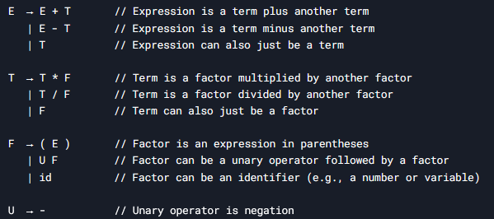
Unary operator

Slide 51
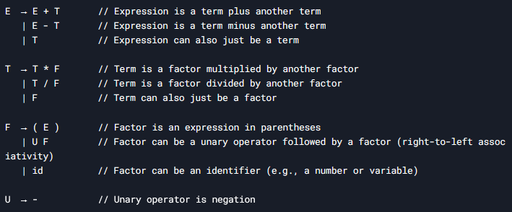

Slide 52
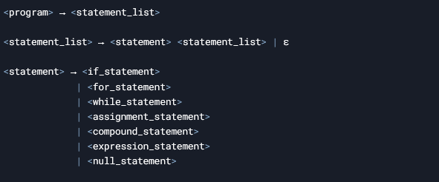
Statement Grammar

Slide 53
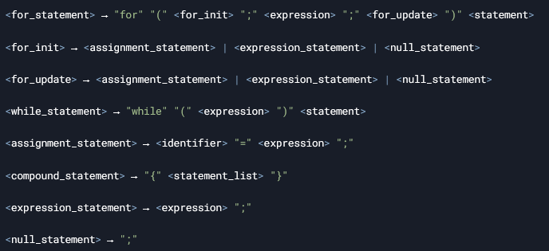

Slide 54
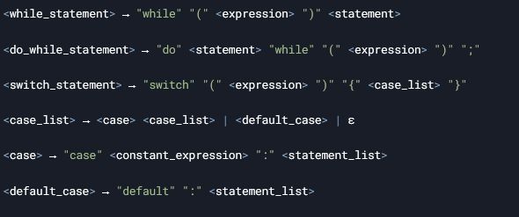
Switch stmt and do-while

Slide 55

Function Declaration/ Defination

Slide 56

Function Call

